Slide 1
Project – Smartphone Trucker Tracker
Problem Contextualization Adam Coetzee - 29982995

Slide 2

What is Fleet Tracker? Why is it important?
A full-stack live tracking solution using Android devices to track Truckers in a fleet
Provides managers of trucking companies a means to ensure truckers are
driving to the correct location
not stopping for excessive amounts of time
driving appropriately, in a steady manner at adequate speeds
Tracks acceleration, altitude, location and speed
Such information allows managers to ensure efficiency

Slide 3
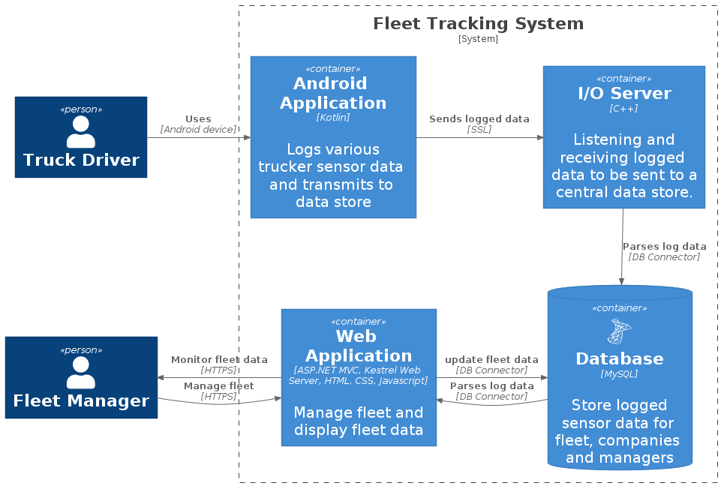
System components

Slide 4
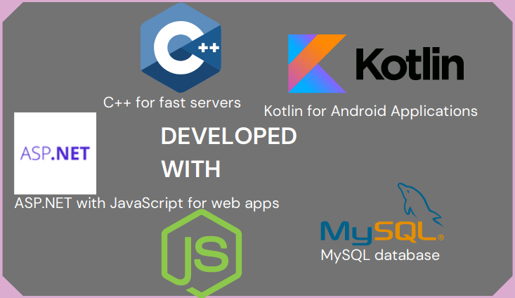
Technologies

Slide 5
Conclusion
System deployed (and tested) to a Linux VPS in docker containers
The required variables are logged (location accurate to 20m)
I/O server and web application maintain indefinite up-time (100%)
More testing required on Android Application, but runs well on Android 10
Further improvements to robustness and up-time can make this solution more reliable
Future expansion could include:
Added integration with on-board vehicle sensors
Improved algorithms and data processing for more accurate readings
Appealling solution for companies who want to use multipurpose devices, with cost-saving potential

Slide 6
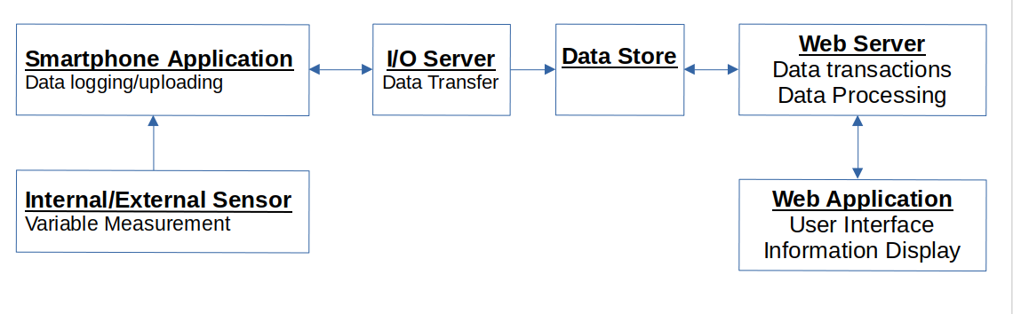
Smartphone Application
To be used by truckers
Log sensor data every 2 minutes
Send data to online server
Not responsible for generating reports

Slide 7
I/O Server
High speed interface between smartphone application and data store
Capable of handling many requests
Only meant for data transfer

Slide 8
Data Store
Storage Structure for trucking logs
Should be suited for many records
Compatiblity with system components

Slide 9
Web Server
Data store access
Data processing – generate daily reports:
locations travelled to
Transit Times
Stopping times
Speed etc.
Server requests to web application

Slide 10
Web Application
User Interface
Access reports about truckers

Slide 11
Conclusion
Deliverables
Smartphone Application
Web Application
Necessary supporting backend
Benefits
Improved monitoring
Potential optimization

